Slide 1
Large Building Energy Usage in NYC Project 1
Theo Love
GA Data Science Class
February 23, 2015

Slide 2
Local Law 84
Large Buildings (> 50k ft2) must submit energy usage information
Energy Usage Intensity (EUI) is gross BTUs of usage divided by square footage
Water usage per square footage
GHG emissions
Data for 2011 and 2012 Available on Open Data NYC

Slide 3
Goals
Work on ways to explain variations in EUI, in particular for Multifamily buildings.
Benchmarking
Identifying ways to help NYC and other building owners lower usage.

Slide 4
Cleaning up Data
Dropped observations without EUIwn
Combined 2011 and 2012 Data
Removed anomalies
Start | 13,390
EUI of 0 | 96
EUIwn > 1,000 | 153
EUIwn < 5 | 62
Floor area < 25k ft2 | 320
Missing GHG | 44
End | 12,715
Also took out 499 water_ft2 > 1,000, but kept rest of observation

Slide 5
Subgroups and New Vars
Subroups
Top 10 Buildings Types
Multifamily
Office
Years 2011 and 2012
Other Vars
Normalized continuous variables
Dummies
Split BBL
Categorical in numeric for graphing

Slide 6
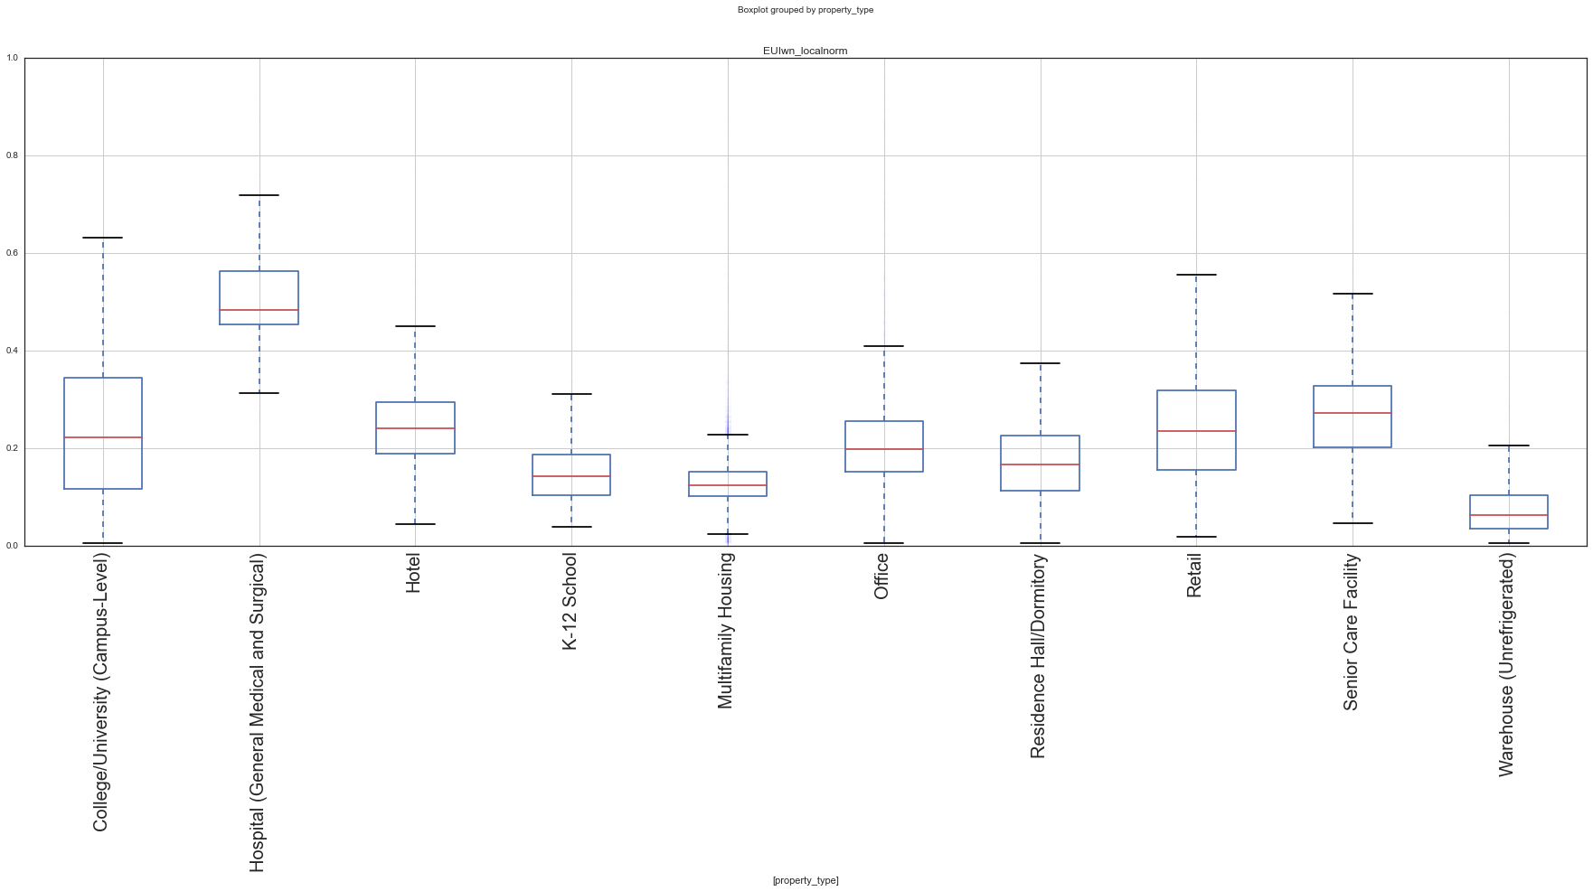
EUI by Property Type

Slide 7
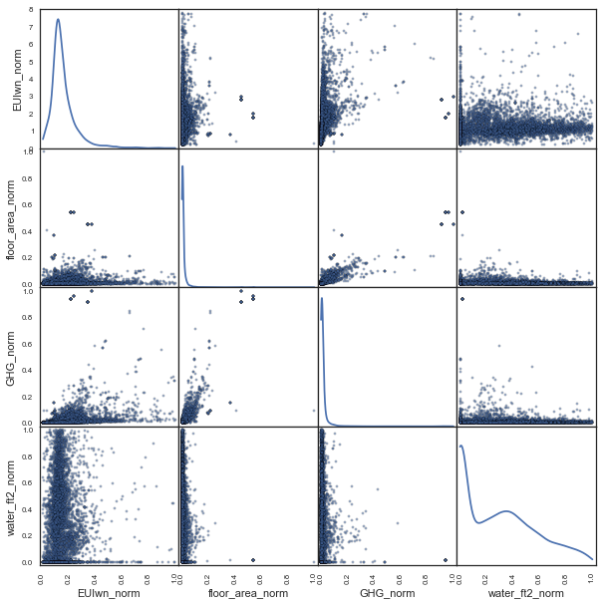
Continuous Variable Relationships

Slide 8
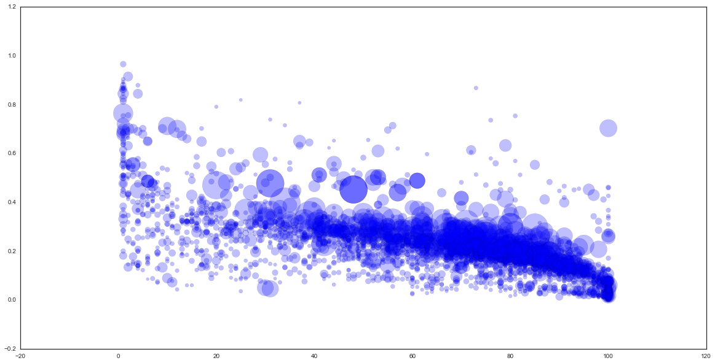
ENERGY STAR – Full Data Set

Slide 9
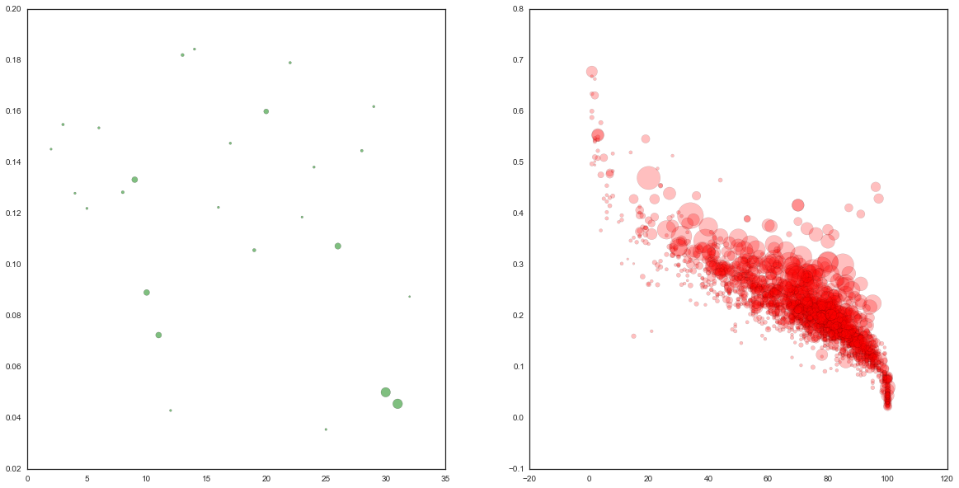
ENERGY STAR – MF and Office

Slide 10
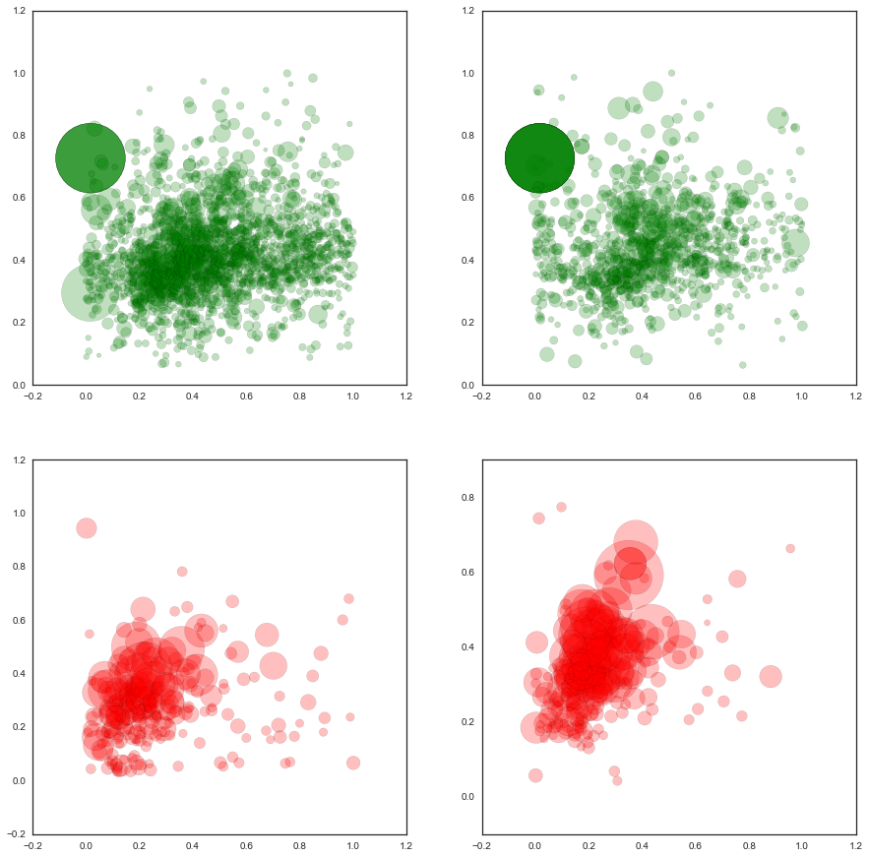
Water Usage

Slide 11
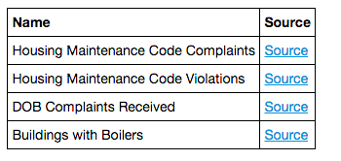
Next Steps
Census Data
New data sources from the City

